Slide 1


Unmanned Aerial Vehicle Flight System Jitter Analysis
William Willie Wells
Notes:
Good Time of day
Defense, title
Work at, funded by

Slide 2
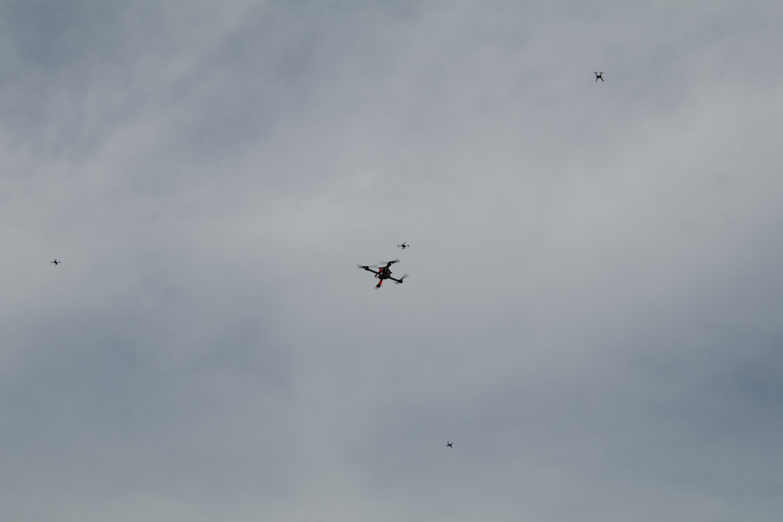
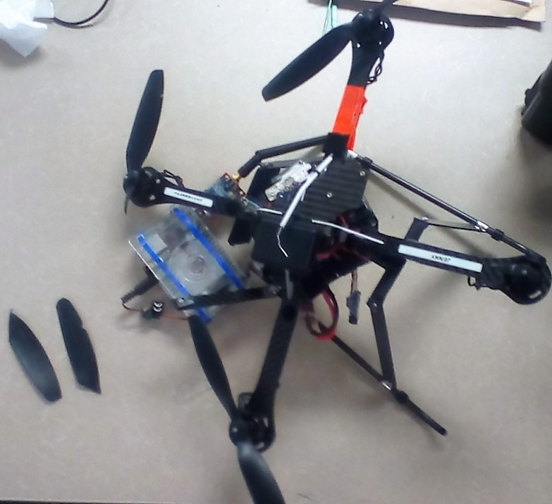
Motivation
Use of UAVs
Advantages:
Man-hours required to perform a task
Human risk in hazardous environments
Economic cost per task
Disadvantage:
Low reliability
Notes:
Increase of UAV use globally, Why should I care?
These advantages, uavs are faster at gathering data, uavs reduce human risk natural disaster, deploy uav cheaper than hiring someone
Manned aircraft more reliable.

Slide 3
Heredia, G., et al. (2009). Multi-Unmanned Aerial Vehicle (UAV) Cooperative Fault Detection Employing Differential Global Positioning (DGPS), Inertial and Vision Sensors. Sensors.
Vu, L., Morgansen, K. A. (2010). Stability of Time-Delay Feedback Switched Linear Systems. IEEE Transactions on Automatic Control.
Sztipanovits, J., et al. (2012). Toward a Science of Cyber-Physical System Integration. Proceedings of the IEEE.
Notes:
Reference of dissertation

Slide 4
Project Investigation Topic
Can an Unmanned Aerial Vehicle be made safe in the presence of unbounded jitter?
Notes:
Research questions
You should start off with the Motivation and Contribution of your work. If your work's motivation is interesting, then I will be motivated to listen. This also can be a good place to present the central research question of your work, so that I can know what I'm supposed to tie what I hear later back to.

Slide 5
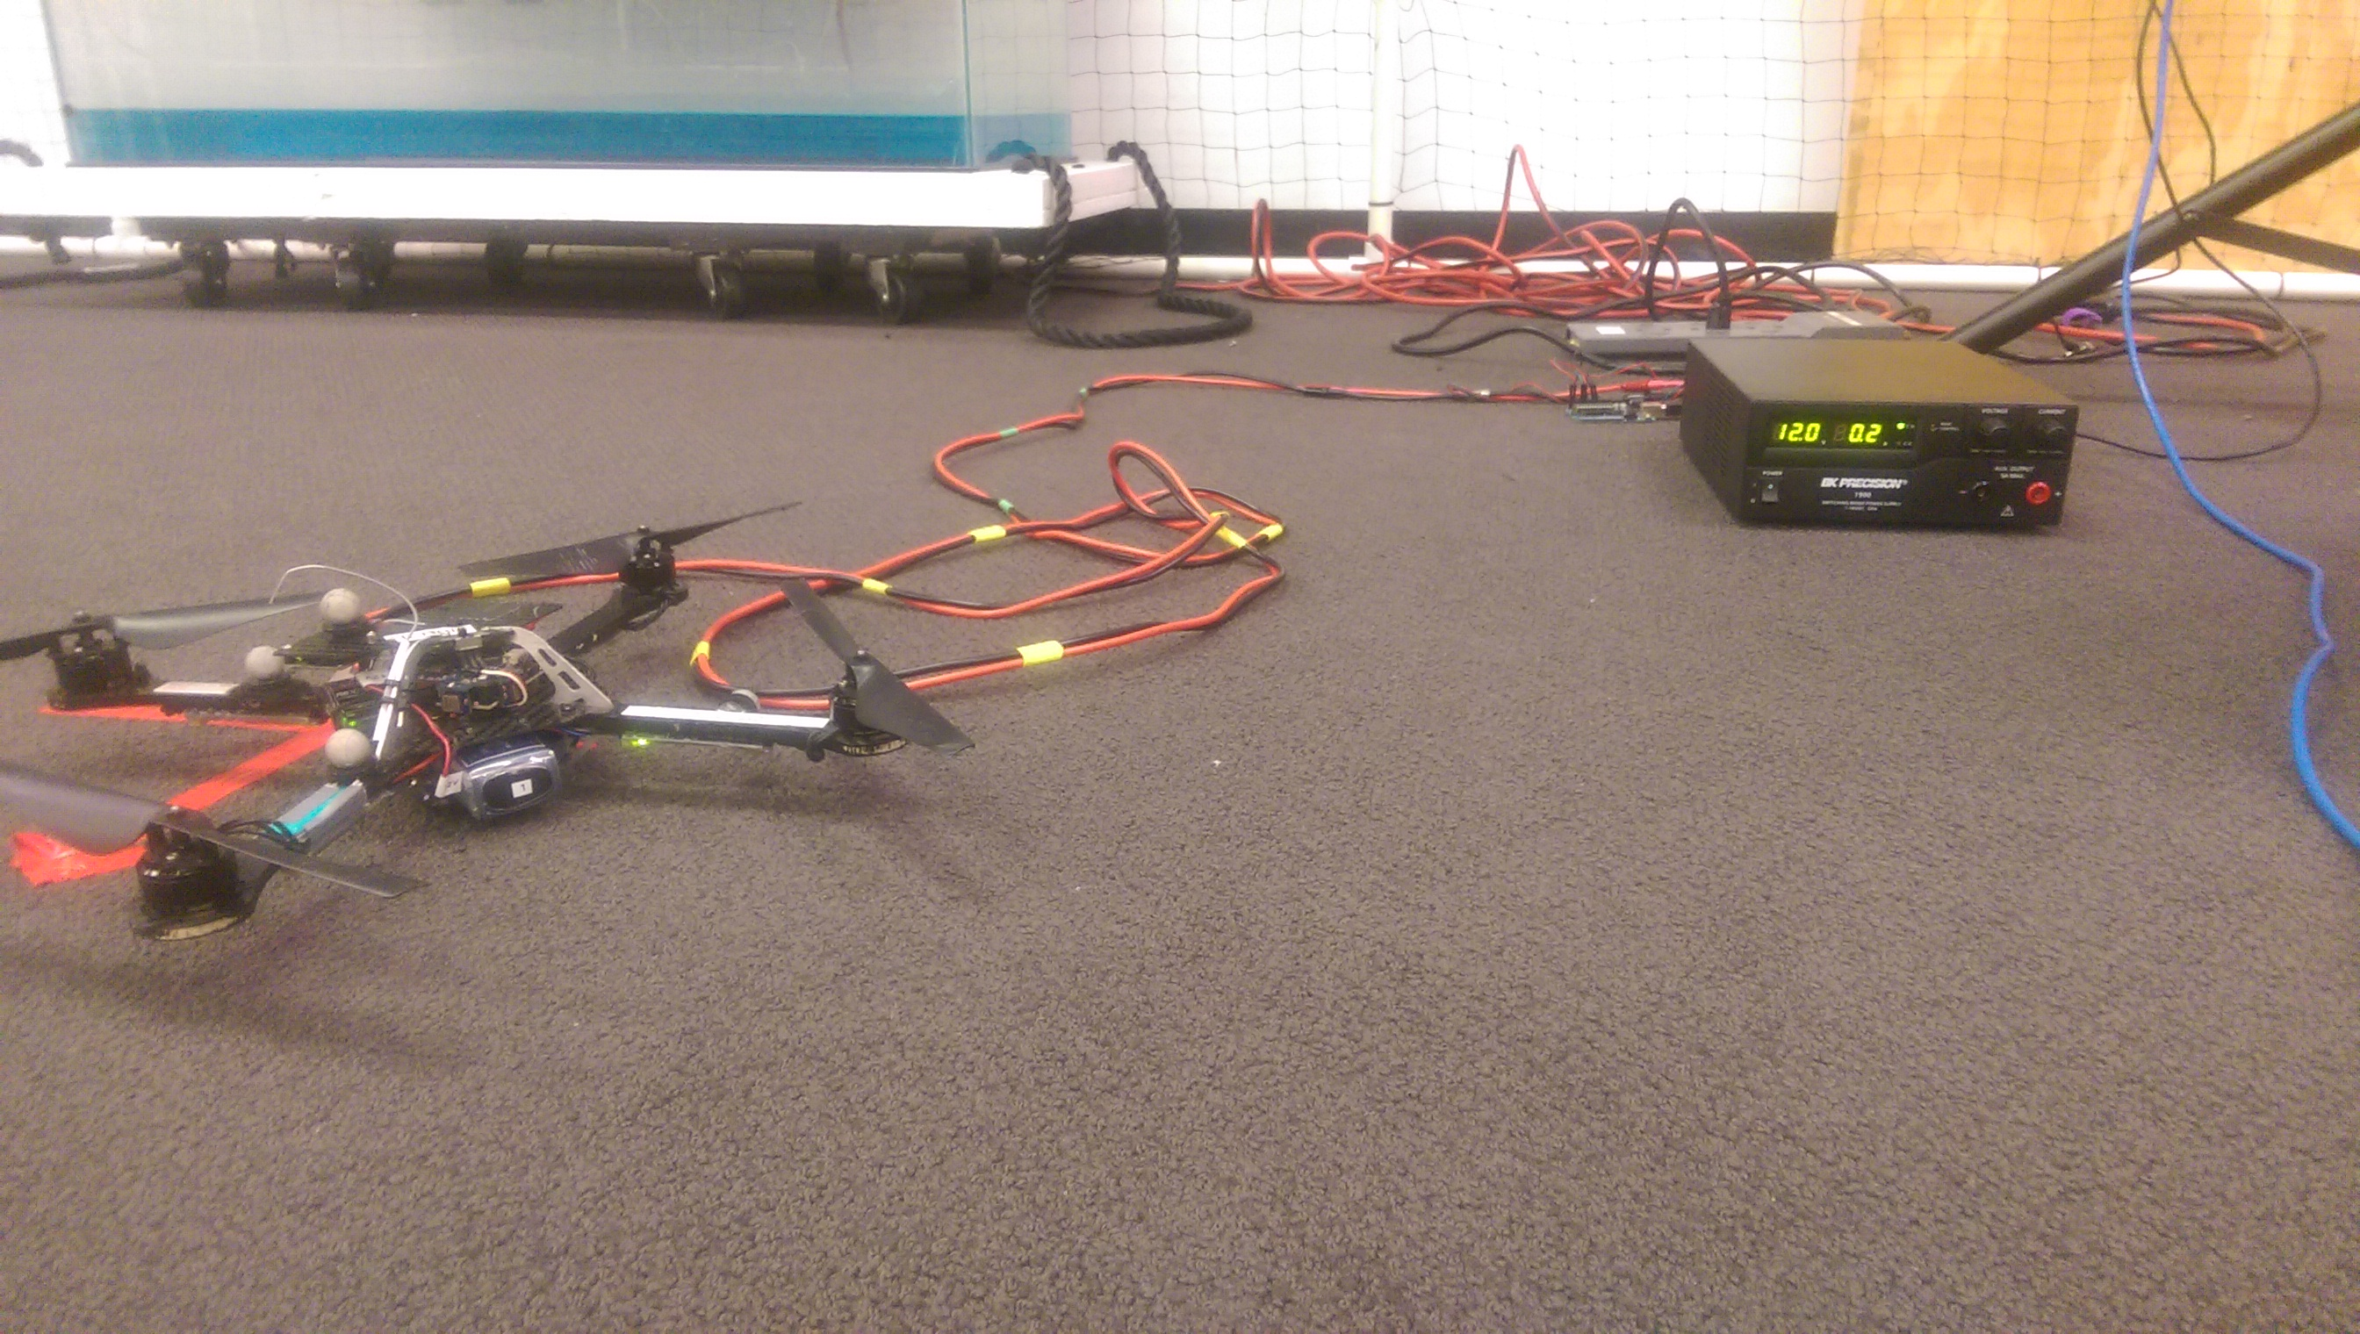
Observable Jitter Symptoms
Additional time taken to perform a maneuver.
Quicker than normal transition through a maneuver.
A maneuver was not observed at all.
Performance of additional maneuvers than those tasked.
Notes:
Picture from setup?
Define failure

Slide 6
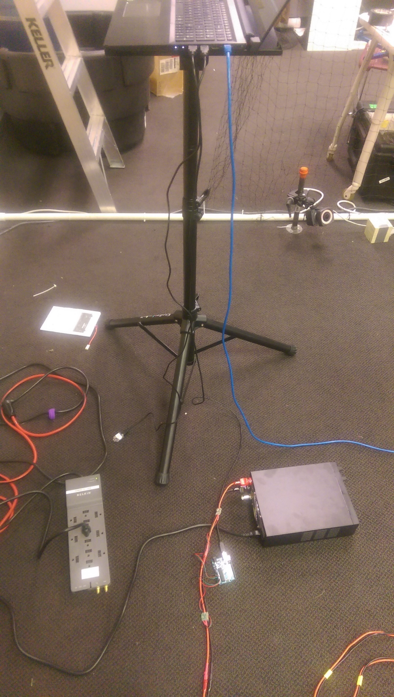
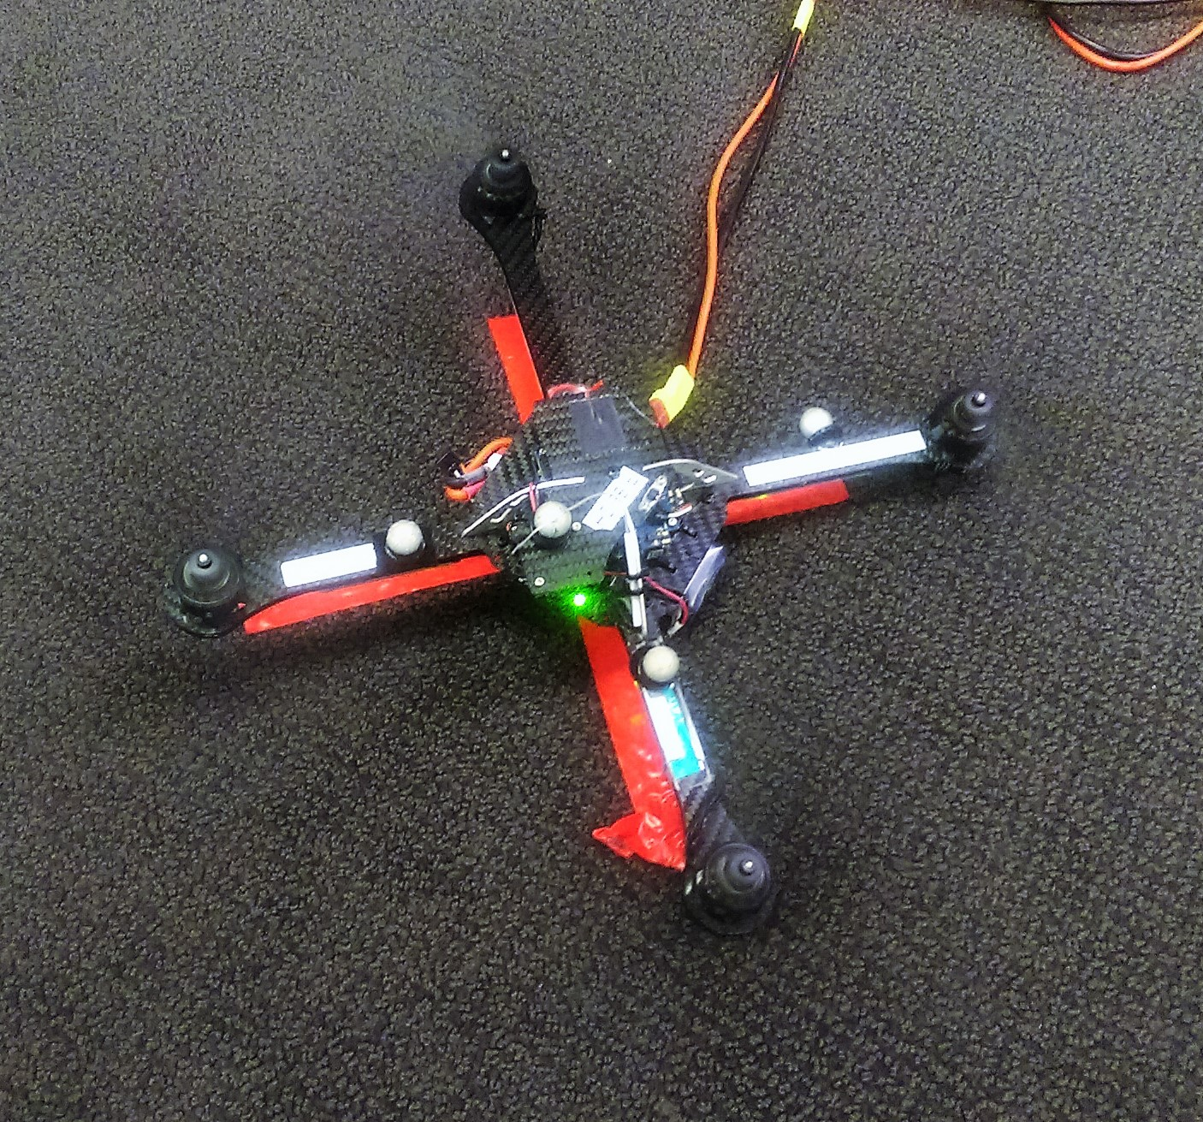
Flight System Failure Test
Manual Flight
Establish communication with DC power supply sensors
Establish communication with Indoor positioning system
Connect Vehicle and DC power supply
Setup
Turn on Vehicle
Establish communication with vehicle
Launch Automatic Testing Software
Observe vehicle as it performs test maneuvers
Testing Software Automatically Shuts Down
Yes
No
Perform Another Test
Cease Testing
Notes:
Formal test procedure
Manual flight – uav working prior to repeated tests
Test setup, start auto test sw, watch test maneuvers, auto test sw shutsdown, change log, start another test
Cage, motion capture cameras and reflective markers, + reduce test bias

Slide 7
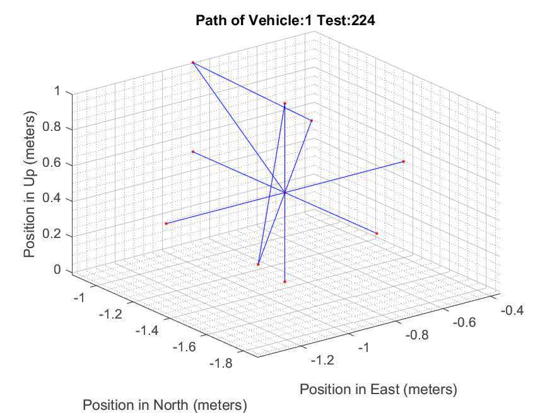
Automated Test Maneuvers
Startup motors
Pitch and roll tests
Launch
Two Axis Translations
w and w/o Rotations
Rotations
Single Axis Translations
w and w/o Rotations
Three Axis Translation
w Rotation
X
X
Down Translation
Land
Shutdown Motors
Notes:
Test operation of motors; 90,180, cw, ccw; 1; 2; 3; land and turn off motors for next test
Replicate basic rotor craft flight maneuvers

Slide 8
Flight System Failures
Notes:
types of failures through repeated flight.
Under these conditions a UAV fails
Hw vs all failures, relate rw; comm interrupt; control input;
Packet time delay signifiicant
Research Question, Setup, Results, and Implication
discuss takeaways from slide; why tests show something valuable; what others can learn from them.

Slide 9
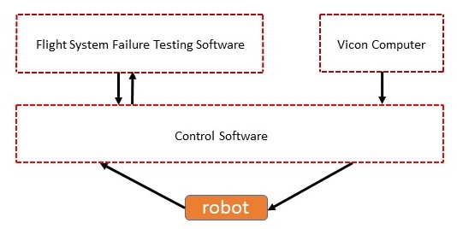
Simple Control Diagram
Process/Thread
Cat5E
XBee-Pro
XBee-Pro
Notes:
from sensor request to control input
Longest path: 12 messages need to be published, sensor (robot), time delay
6th msg longest path – Testing Software
Shortest path: 6 messages, sensor (Vicon) → control input
The following example display delay Vicon and control, there are delays on long path

Slide 10
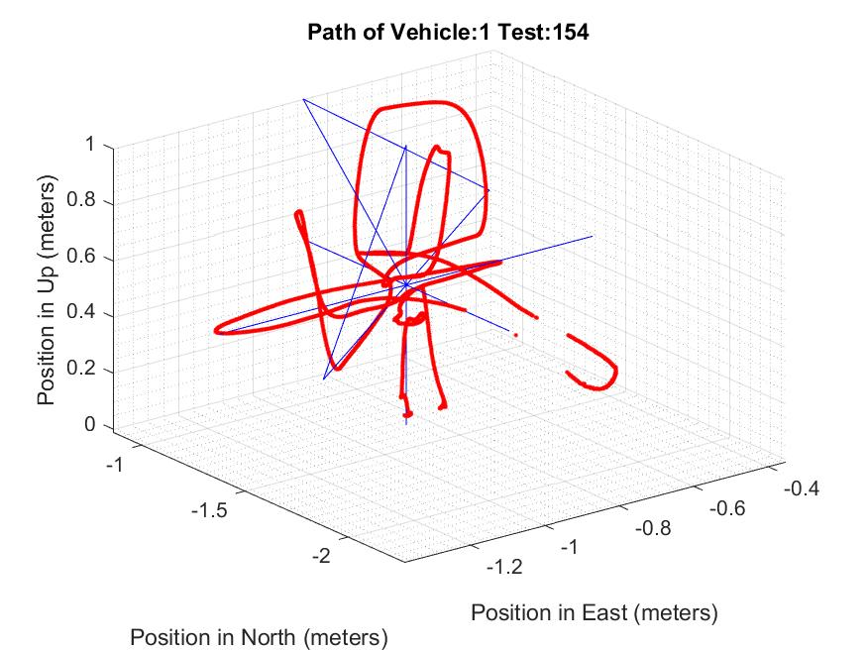
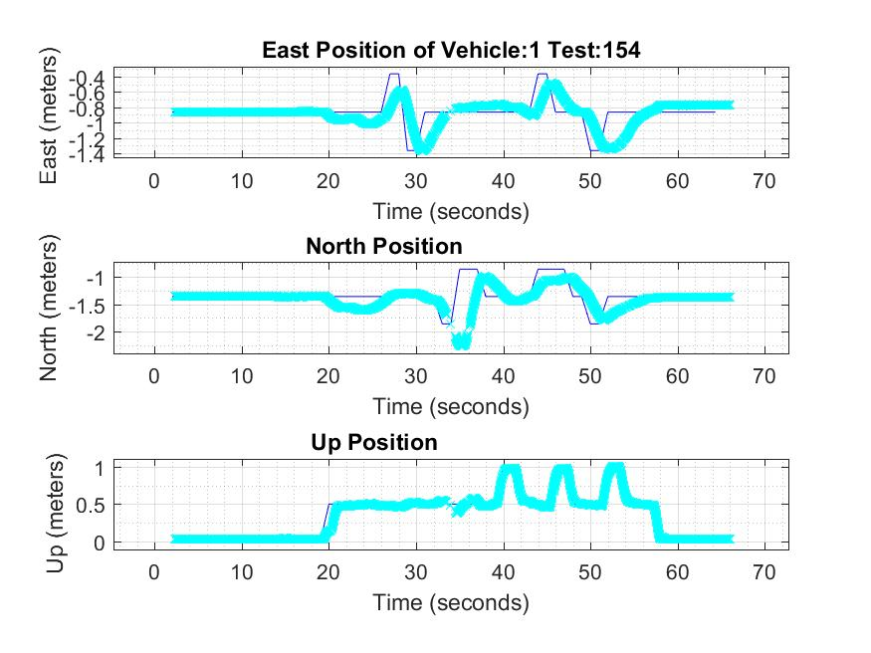
Packet Time Delay Example 1
Legend: Control Software Position Target Position
Legend: Control Software Position Target Position
Notes:
Time delayed control messages accounted for 125 failures.
Vehicle position topic – do not say subject pose
Effect of position vs time

Slide 11
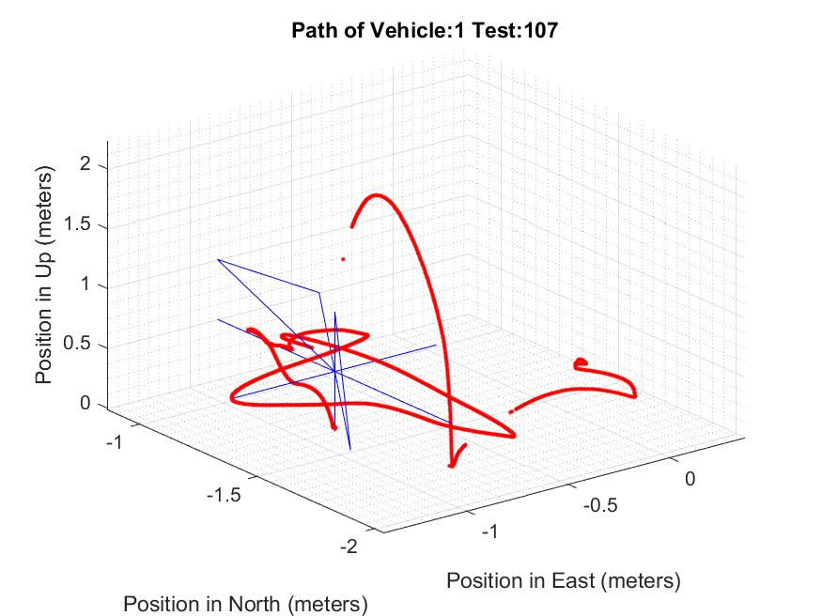
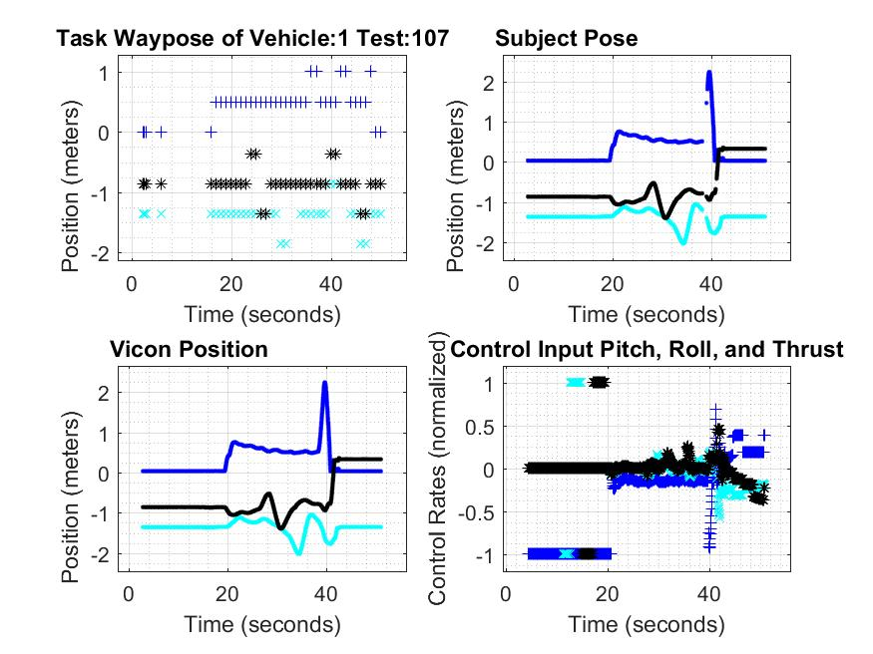
Packet Time Delay Example 2
Legend: East North Up
Legend: Control Software Position Target Position
Notes:
This time delay will cause the controlled system to exhibit unexpected behavior.
discuss why this is important and what can be learned from this.

Slide 12
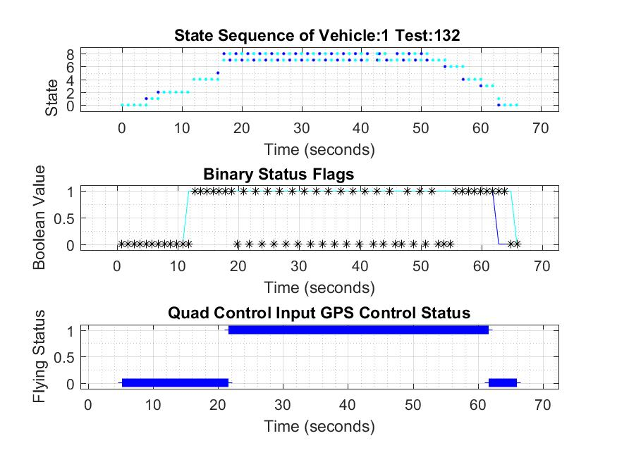
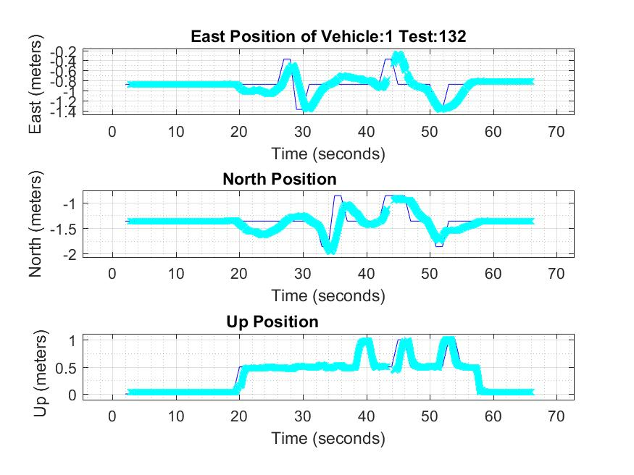
Packet Time Delay Example 3
Legend: Target State Control Software State
Legend: Control Software Position Target Position
Notes:
Describe state, (flight vs ground states), legends, dots
mo
Time delay in state progression, rate → poll status 1 sec

Slide 13
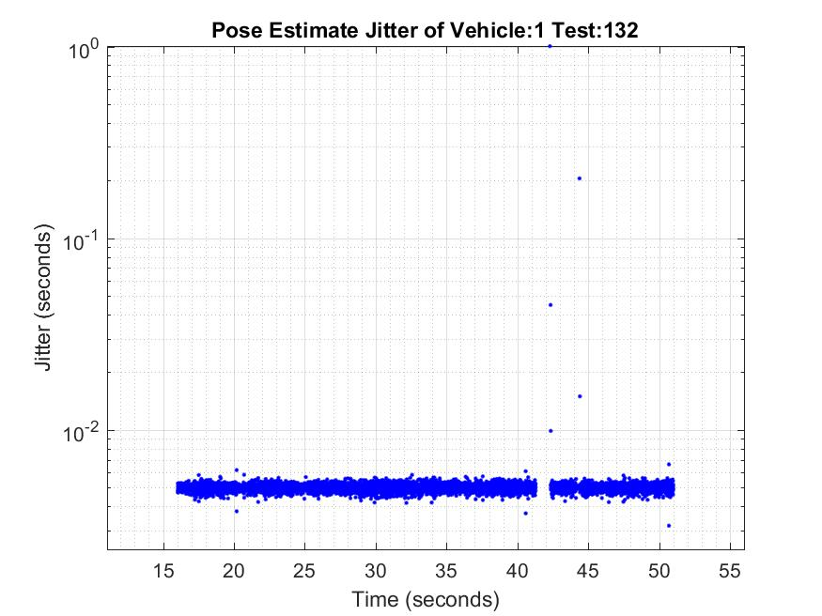
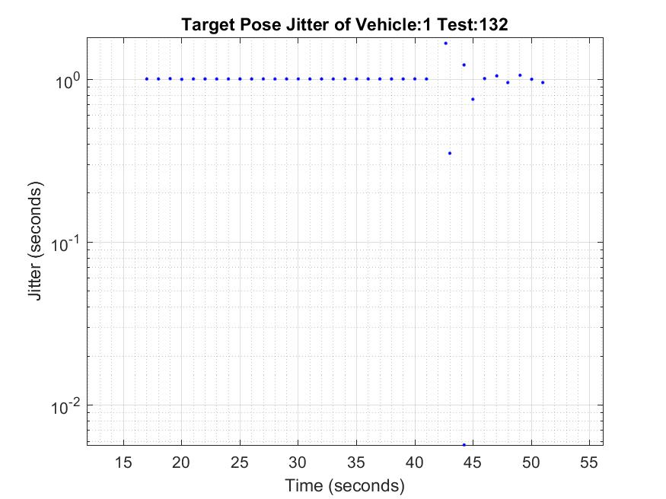
Pose Jitter

Slide 14
Method
if(state.state > 6){
if(fabs((ros::Time::now() - ctrl_pose_time).toSec() - 1.0) > 0.2){
ROS_WARN(" Target Pose jitter is: ~%f",(ros::Time::now() - ctrl_pose_time).toSec());
failure = true;
}
}
ctrl_pose_time = ros::Time::now();
Monitor Node
Notes:
40 tests, 1.1,rate

Slide 15
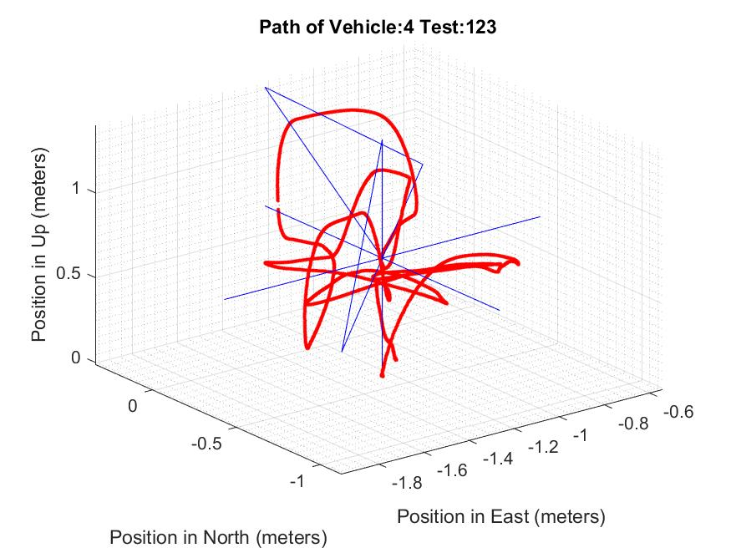
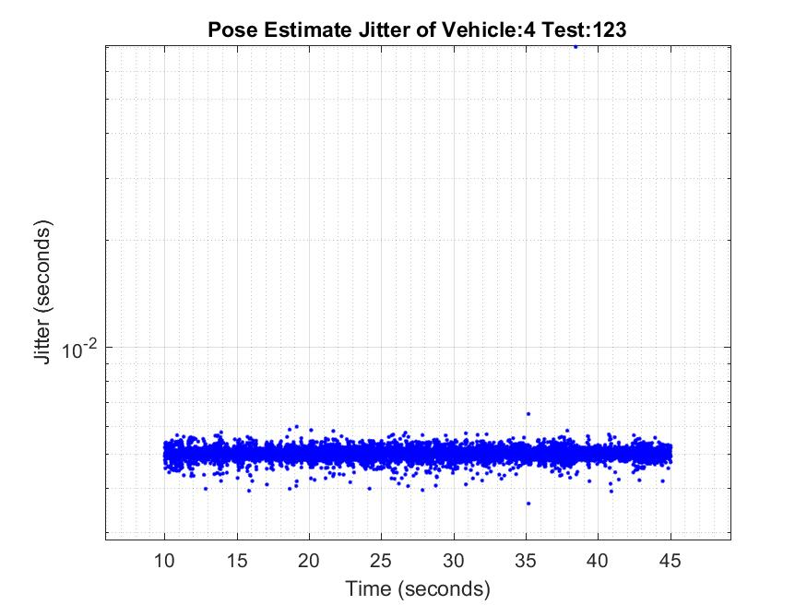
Experiments
Notes:
40 tests, 1.1

Slide 16
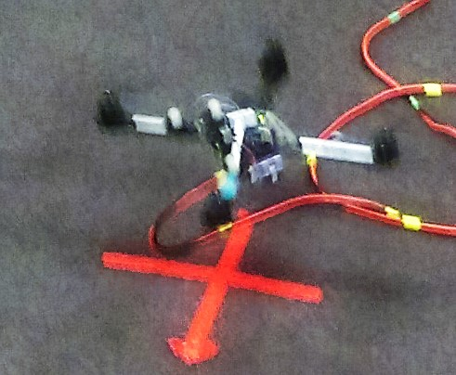
Future Work
Simulation observer and logs
Inject artificial jitter
Notes:
to remind people of what you did.
Navigation task for radio test, manual piloted, test and automate outdoor nav

Slide 17
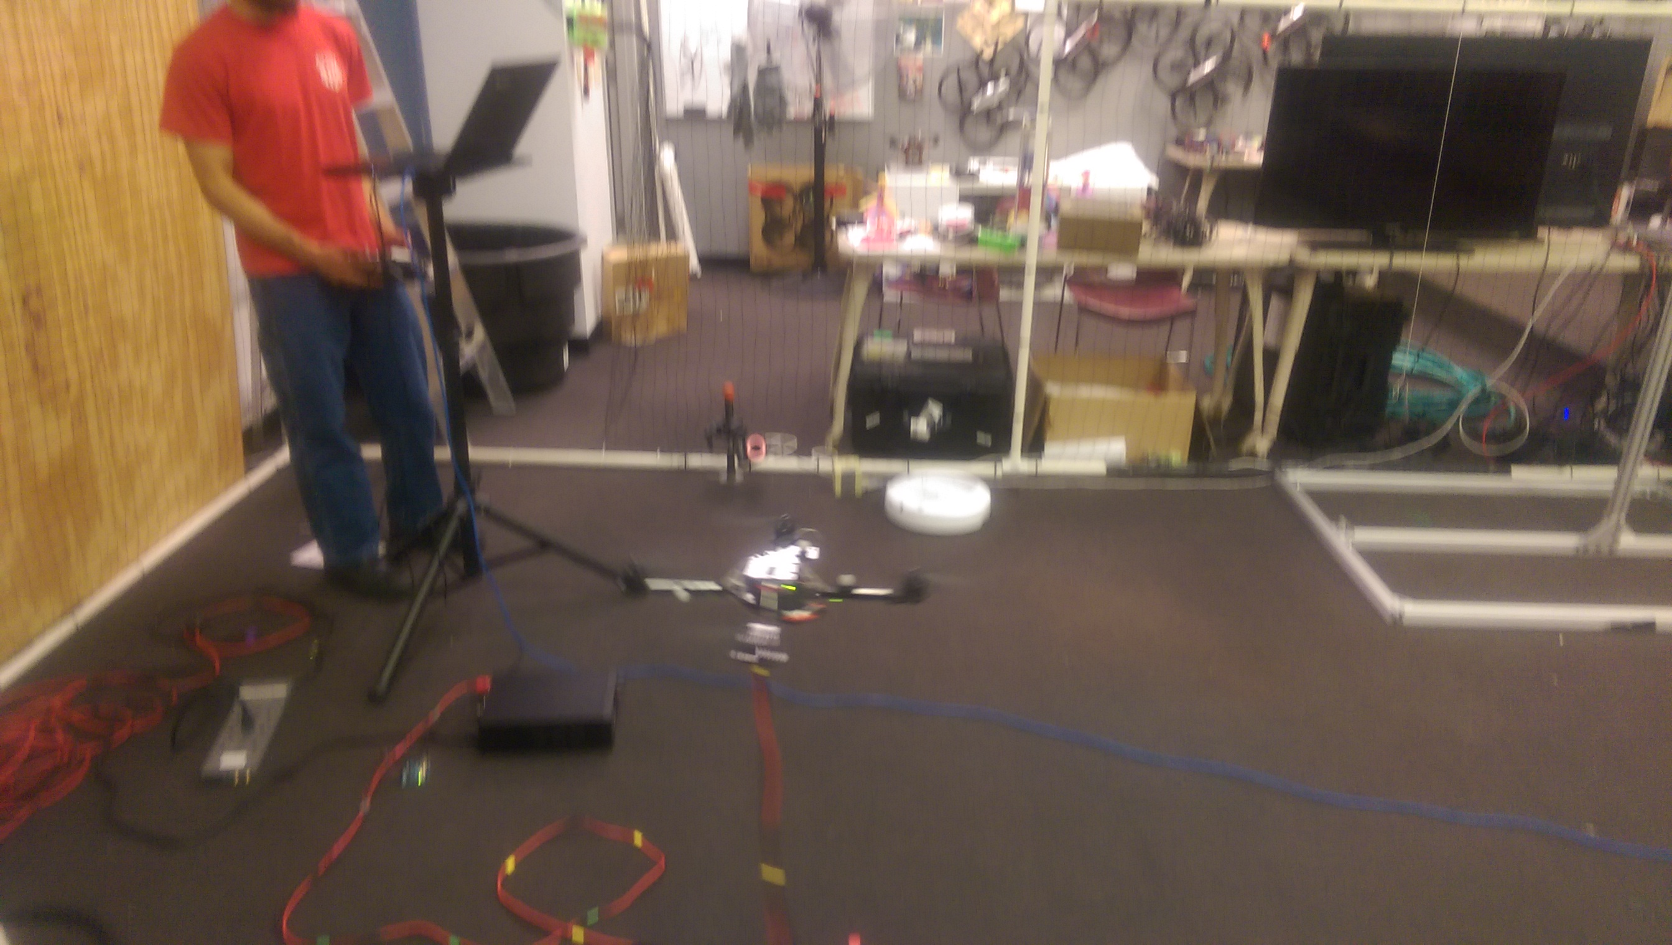
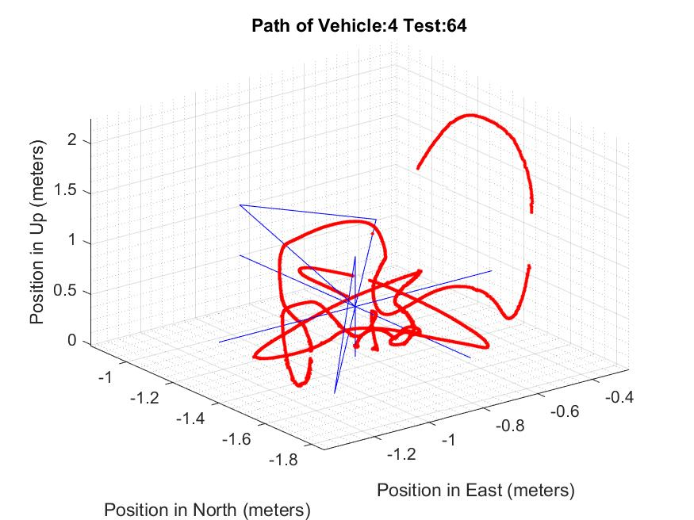
Summary
Reduce detrimental effects jitter
Pitch and Roll tests
Monitor and warn jitter
Notes:
Rotor craft, hover, presence of delayed packets, safer system
No correlate Power and vehicle performance
ARDrone propellers → increased power consumption, no difference other 2 types.
Propeller type, no effect, position error measurements

